Slide 1

Social Buzz Analytics
Goal
Development of Interactive contents analytics dashboard of Social Buzz to highlight the top 5 contents category.
Client name: Social Buzz
Client industry: Social media & content creation
Year established: 2010
Location of HQ: San Francisco

Slide 2

Role
Data Analyst

Slide 3

Project Objective
An analysis of Social Buzz content categories that highlights the top 5 categories with the largest aggregate popularity

Slide 4

Social Buzz
Social Buzz emphasizes content by keeping all users anonymous, only tracking user reactions on every piece of content. There are over 100 ways that users can react to content, spanning beyond the traditional reactions of likes, dislikes, and comments. This ensures that trending content, as opposed to individual users, is at the forefront of user feeds. Over the past 5 years, Social Buzz has reached over 500 million active users each month. They have scaled quicker than anticipated and need the help of an advisory firm to oversee their scaling process effectively. Due to their rapid growth and digital nature of their core product, the amount of data that they create, collect and must analyze is huge. Every day over 100,000 pieces of content, ranging from text, images, videos and GIFs are posted. All of this data is highly unstructured and requires extremely sophisticated and expensive technology to manage and maintain. Out of the 250 people working at Social Buzz, 200 of them are technical staff working on maintaining this highly complex technology

Slide 5


Process
Datasets filtering to select right dataset
Dataset cleaning
Dataset Transformation and data modeling
Dataset Merging into single table
Analytics Report in Power BI Editor
Development of interactive Dasboards

Slide 6
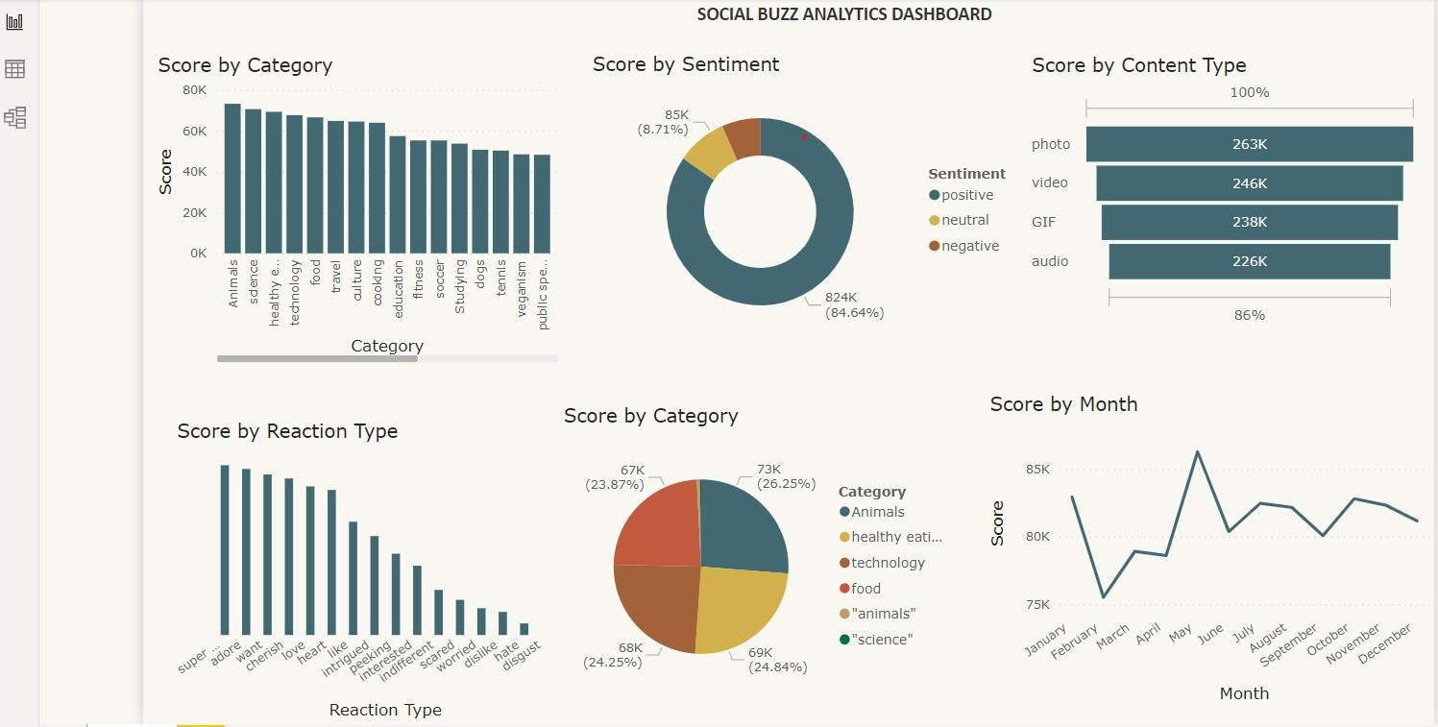

Insights Dashboard

Slide 7


Insights
Top 5 Contents Category score
Animals 73271
Science 70662
healthy eating 69339
technology 67689
food 66626
Percentage Sentiments Analysis
84.64% positive
8.71% Neutral
6.65% Negative
count of content type
photo 263k
video 246k
GIF 238K
audio 226k

Slide 8


Insight
Top 5 Reaction Type score
Super love 113925
adore 111456
want 107730
cherish 105070
love 99710
Time-series Analysis
May has the highest content score
February has the lowest content score

Slide 9

Summary
More ads content related to Animals, Science, healthy eating, technology and food should be incorporated into Social Buzz platform to increase traffic, improve impression, views and clicks there by increasing ads conversation rate and improving business revenue.
The reactions from users indicated massive positive sentiments.
May records the highest contents score and June records the lowest in time series analysis of contents posted over 12months calendar year.

